Slide 1
Introduction to programming with R
Gabriel Rosenfeld, PhD
Data Scientist
Bioinformatics and Computational Biosciences Branch

Slide 2
Bioinformatics and Computational Biosciences Branch (BCBB)
My background: Data Scientist in the Bioinformatics and Computational Biosciences Branch in the Office of Cyber Infrastructure and Computational Biology
Check us out: https://bioinformatics.niaid.nih.gov/researchcollaborationandsupport
Do you conduct research involving genomics (clinical, meta and microbial), imaging, data science and biostatistics, or structural biology?
We offer collaboration opportunities to address research questions at no direct cost to the NIAID research community and collaborators

Slide 3
Why learn R?
Top 20 programming language according to TIOBE index and top 10 language in PYPL list (July 2022)
Significant usage within biomedical research community as well as a high demand skill from employers
It is specially suited for data analysis, statistics, visualization, machine learning, and other tasks within data science
Useful tool especially with complement of another language like python if focused on data science as a career path

Slide 4
What is R?
Created by Ross Ihaka and Robert Gentleman – the name derived from the first letter of each of their names
First released in March of 1995
More than 2 million people use the programming language worldwide
Over 18,000 packages in CRAN repository that do various tasks and analyses
FOSS (free and open-source) software

Slide 5
How does one use R?
Can be used on the command line
Better used within an IDE (integrated development environment) such as Rstudio
Load data, install R packages, and then interactively explore, visualize, analyze, and report results

Slide 6

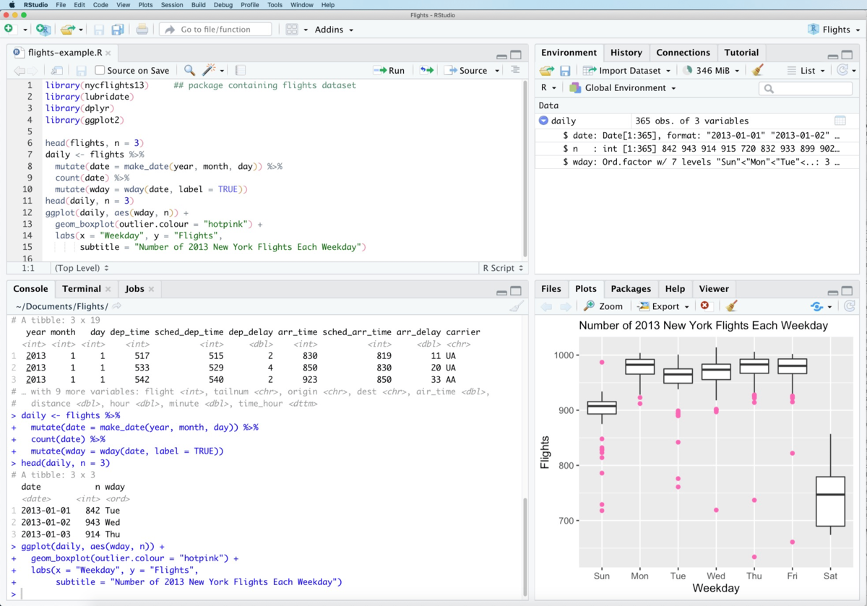
RStudio - Wikipedia. (2022). Retrieved 19 July 2022, from https://en.wikipedia.org/wiki/RStudio

Slide 7
Specific features of R programming language
Interpreted language : it means that the computer does not first compile all the code instructions into machine language instructions
Vector-oriented: it means that a function like 1 + x does not care if x is one number or many (it will add 1 to each element of the vector)
Lexical scoping: variable name only exists within scope of the text of a specific function and cannot be accessed outside of it
As opposed to dynamic scoping where variables exist during the time a specific function is being called
TLDR: most of the time lexical scoping is what is intended by the user
Influences include functional programming and object-orientation
Indexing starts at 1 rather than 0 (e.g. as in Python)

Slide 8
Where to find R?
Within NIAID, you can use self-service or on the LOCUS HPC cluster:
Windows Software Center: https://inside.niaid.nih.gov/it-equipment/installing-scientific-software-using-software-center
Mac self-service: https://inside.niaid.nih.gov/it-equipment/installing-scientific-software-mac-self-service
NIAID Locus: https://inside.niaid.nih.gov/media/locus-high-performance-computing-hpc-support-portal
Within NIH, you can use the Biowulf HPC cluster: https://hpc.nih.gov/
Download and install R and Rstudio:
R: https://www.r-project.org/
Rstudio: https://www.rstudio.com/

Slide 9
Tutorial overview
I will provide a tutorial of using R in the next part of the webinar
Next slides will cover the pre-requisites and the set-up if you would like to follow along
I will keep advancing during the tutorial to ensure we complete it and will try to keep a reasonable pace
If you simply want to listen and complete the tutorial later or if you get stuck, no worries…
You can go back to the material and complete later
Goal today is to introduce the material and demonstrate its use

Slide 10
Pre-requisites for tutorial
You will need to have R and RStudio installed, and the course materials downloaded from GitHub
R version 4.2.1+ (https://cran.r-project.org/)
Rstudio (https://www.rstudio.com/products/rstudio/)
Location of course materials: https://github.com/niaid/Data-Science-with-R
If within NIAID, consider self-service for R and Rstudio install:
Windows self-service: https://inside.niaid.nih.gov/it-equipment/installing-scientific-software-using-software-center
Mac self-service: https://inside.niaid.nih.gov/it-equipment/installing-scientific-software-mac-self-service
We will be using the R markdown file (intro_programming_in_r.Rmd)
There are also detailed instructions in the .Rmd for the initial required software and set up

Slide 11
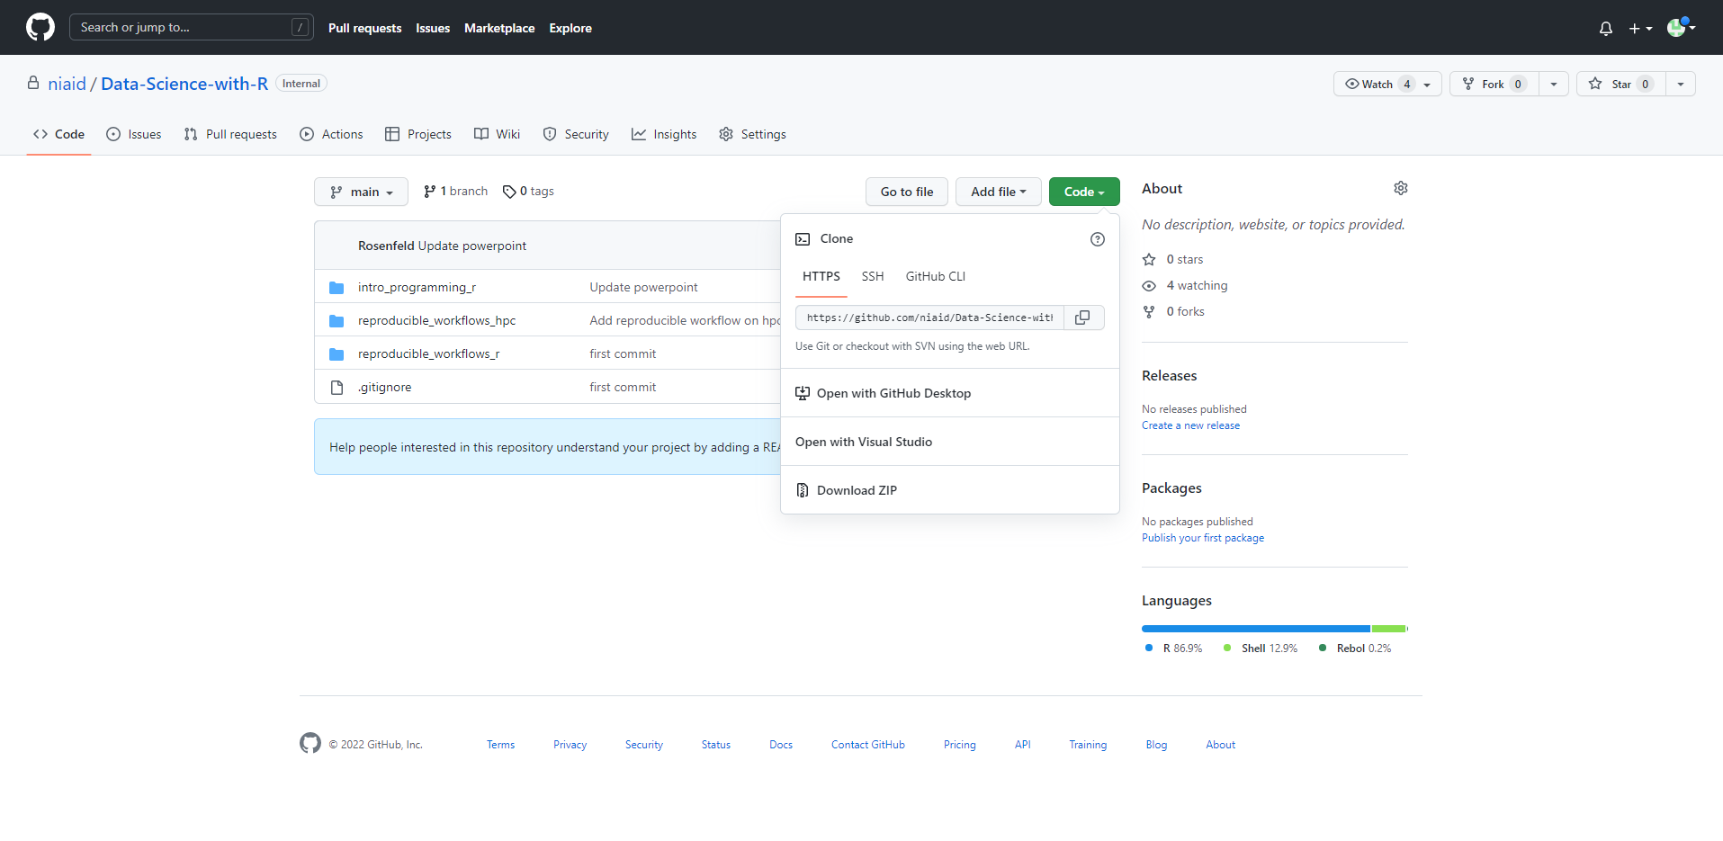
Tutorial Set Up
https://github.com/niaid/Data-Science-with-R

Slide 12
Tutorial Set Up
Unzip the downloaded file in your downloads folder
Open the subfolder “intro_programming_r” and then the “intro_programming_r.Rproj” file
If Rstudio is installed, then this should open the project in RStudio

Slide 13
Tutorial Set Up
While installing packages during tutorial, you will need to be off any VPN as this may interfere
In the Rstudio console (bottom left tab), add the following code below and then hit enter:
install.packages(“renv”)
Now add the following code to the console and hit enter after each:
renv::restore()
Write “y” to any prompts
Open the “intro_programming_in_r.Rmd” file, which should pop up in the upper left quadrant of RStudio

